Slide 1
Windows Server 2019 and Active Directory Lab Setup
By: Matthew Delgado

Slide 2
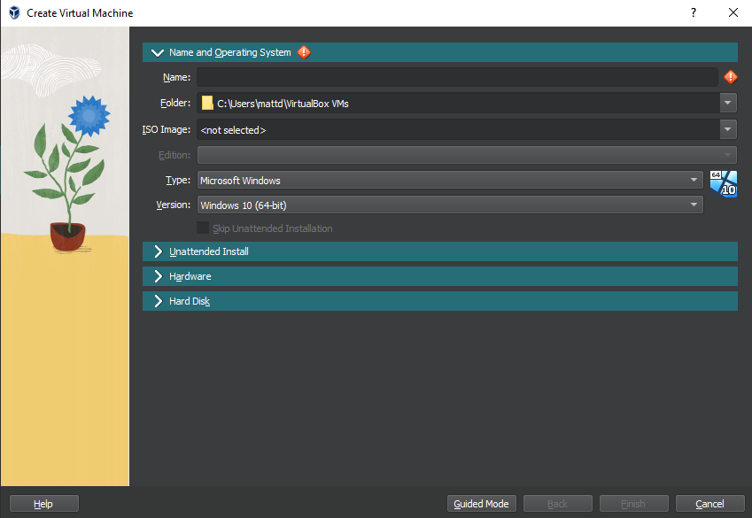
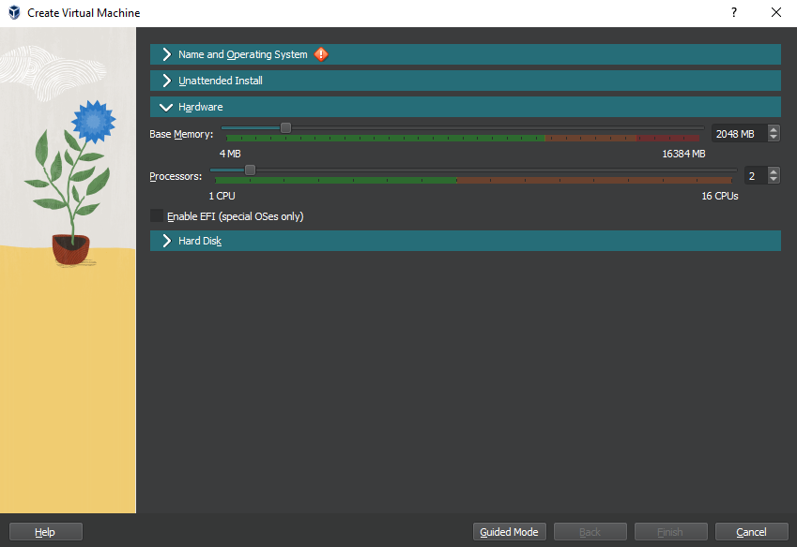
Windows Server 2019 VirtualBox Setup
Name and OS
Ensured “Type:” is set to Microsoft Windows
Version: Windows 10(64-bit)
Iso Image: Windows Server 2019 Essentials
Selected to Skip unattended Install
Hardware:
Base Memory(RAM): 2048 MB
Processors: 2 CPU cores

Slide 3
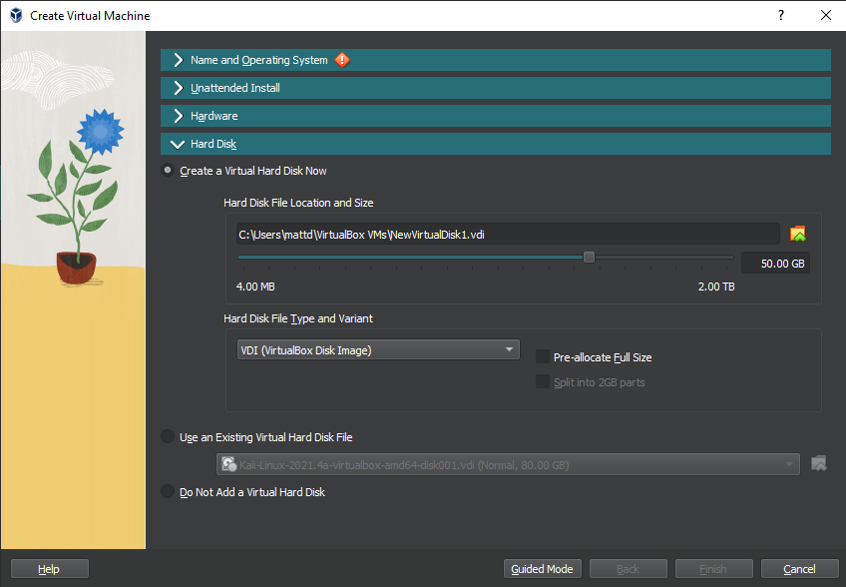
Windows Server 2019 Setup (cont.)
Hard Disk:
Select Create a Virtual Hard Disk Now
Size: 50 GB (32 GB Microsoft recommended minimum)
Hard Disk File Type:
VDI (Virtual Disk Image)
Do not select “Pre-allocate Full Size”

Slide 4
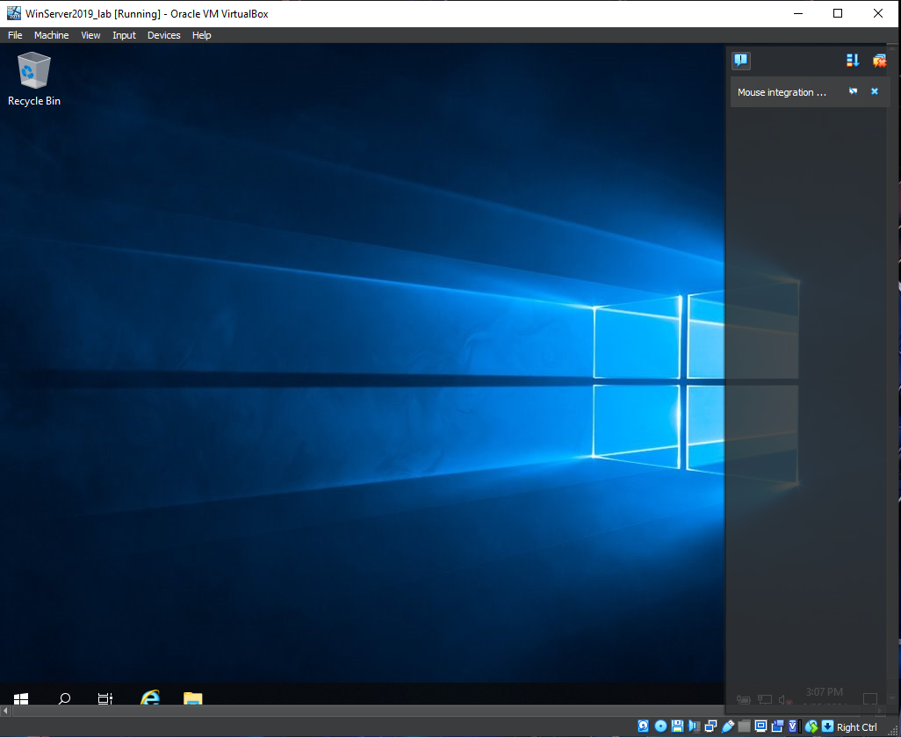
Windows Server 2019 Setup (cont.)
Finish and boot up the virtual machine
Windows Server will begin to install
Once finished it will take you to the desktop

Slide 5
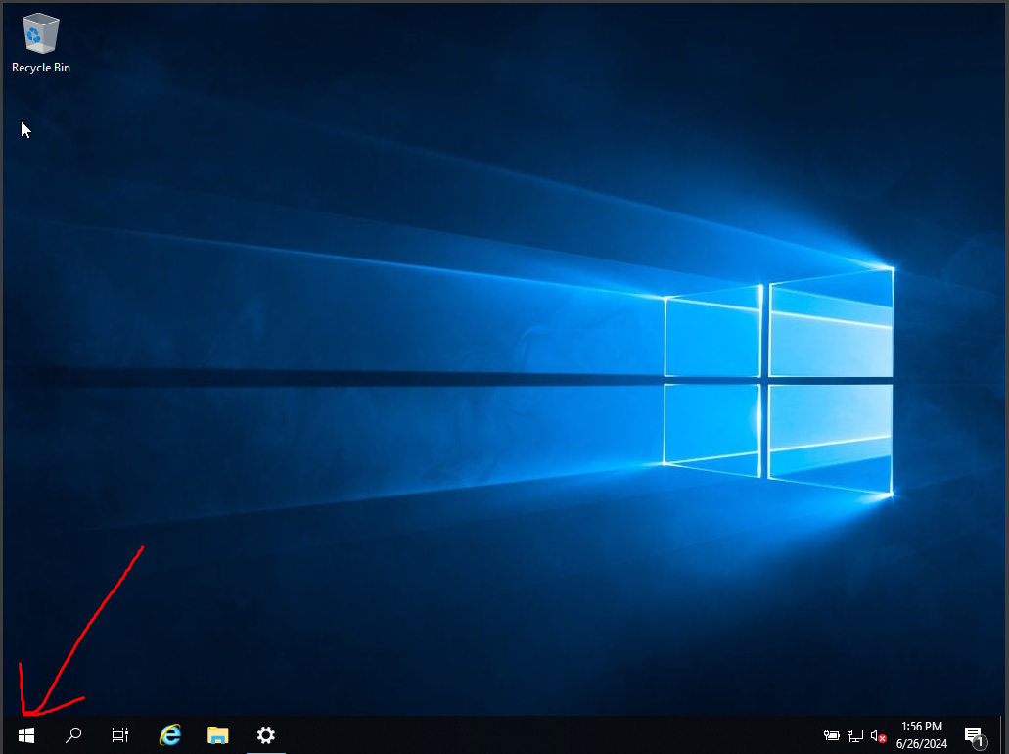
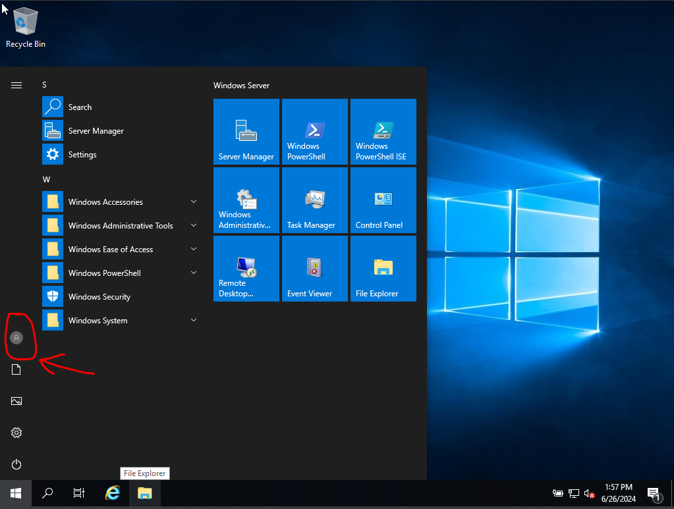
Activate Windows Server 2019
Select Start Icon in bottom corner
Select user icon > Change account Settings > Activate Windows Now

Slide 6
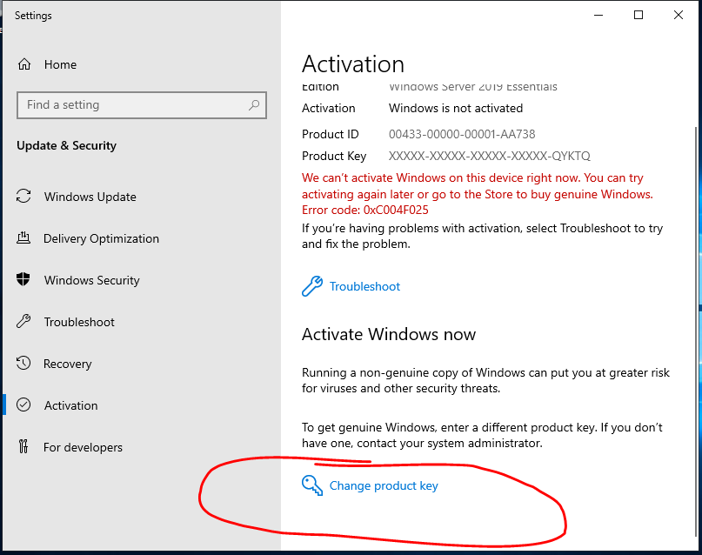
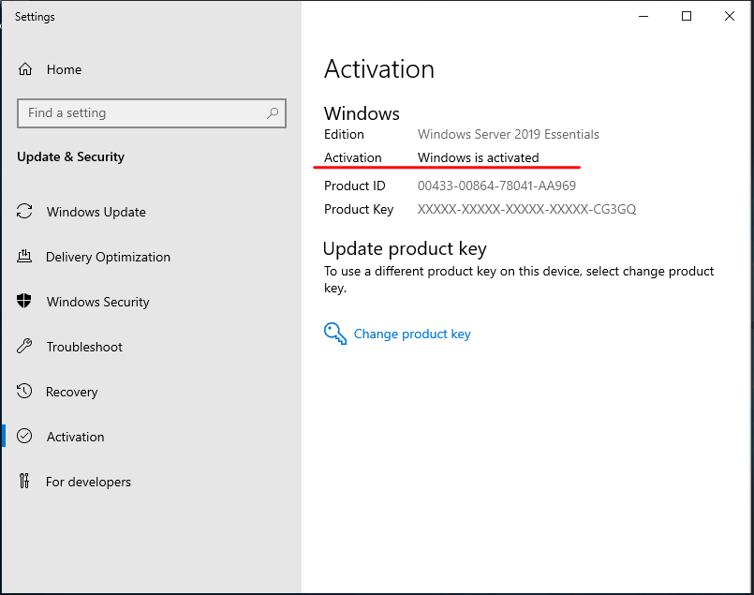
Activate Windows Server 2019 (cont.)
Select “Change Product Key”
Enter your product key and then select to activate

Slide 7
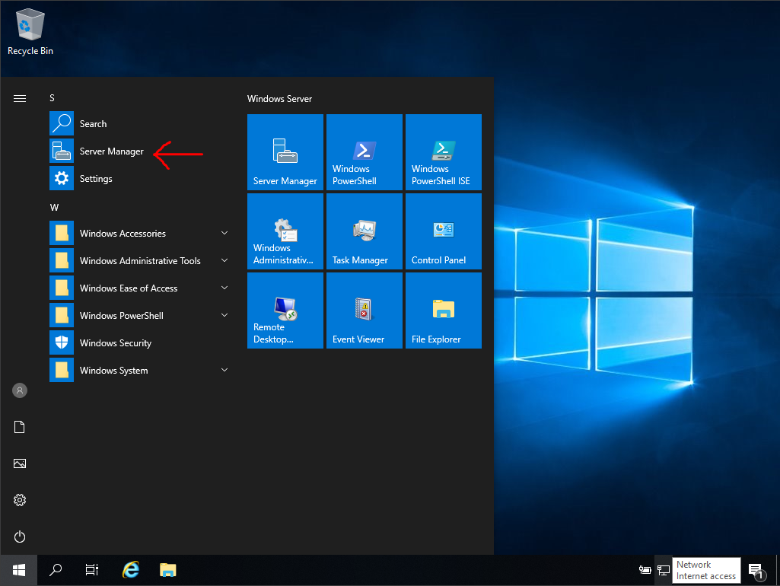
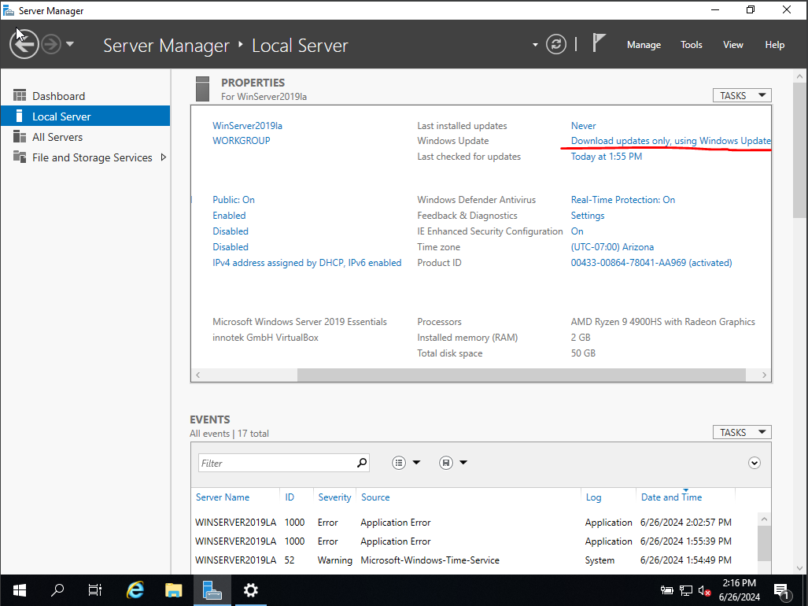
Windows Server Basic Configuration Task
Select the Start Icon > Click Server Manager
At the Server Manager Dashboard select “Local Server”
Under the “Properties” pane select the link next to “Windows Update” to check for updates

Slide 8
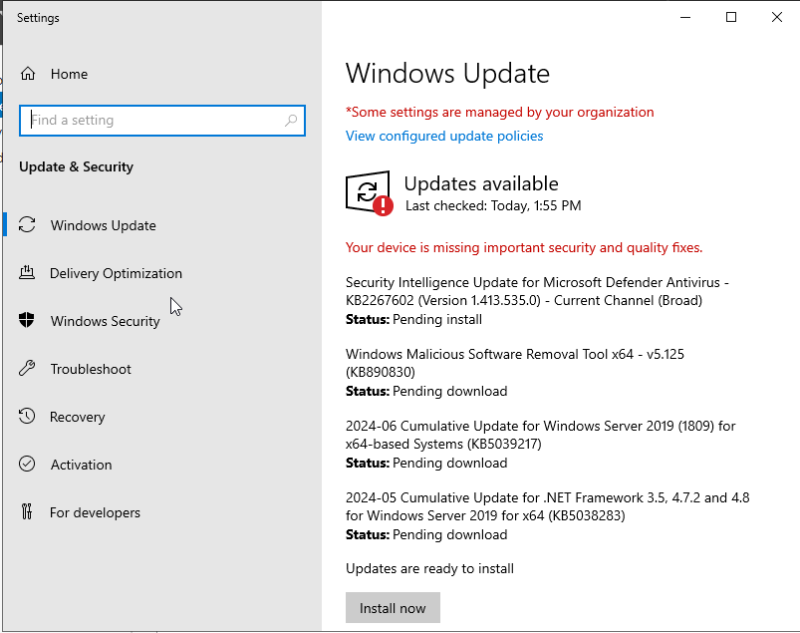
Windows Server Basic Configuration Task (Update Windows Server Cont.)
Select “Install now” to download the latest updates

Slide 9
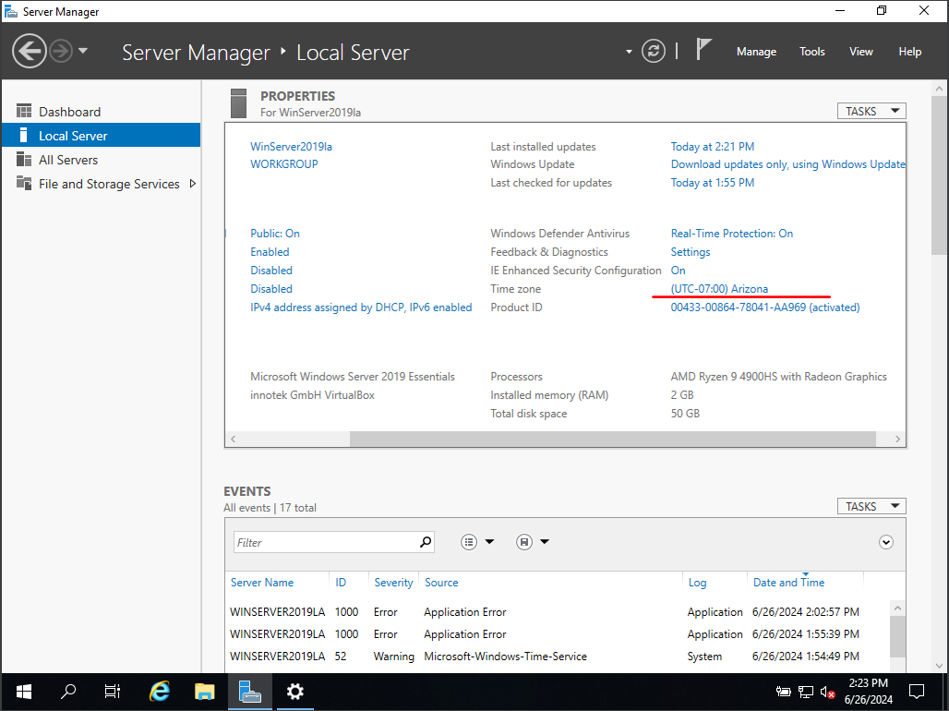
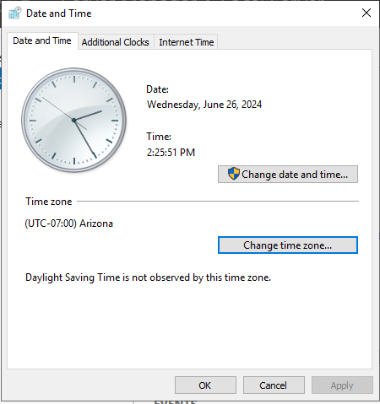
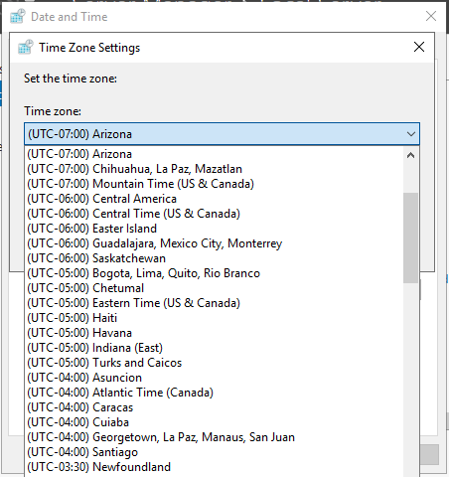
Windows Server Basic Configuration Task (Time zone)
Ensure time zone is correct
If not click the link next to “Time Zone” > Select “Change time zone…” > Select desired time zone from the drop-down box

Slide 10
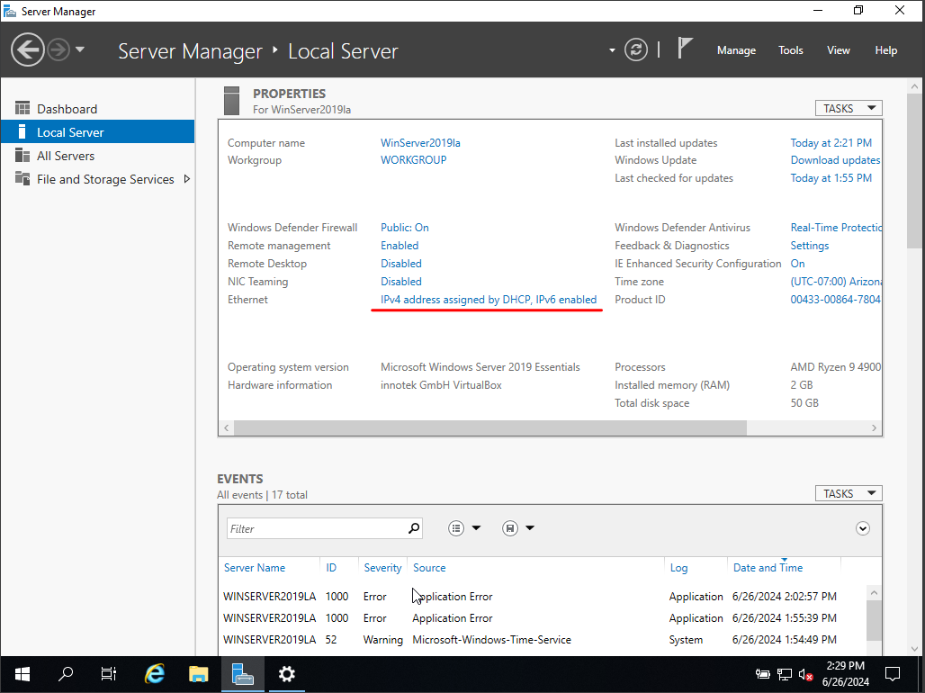
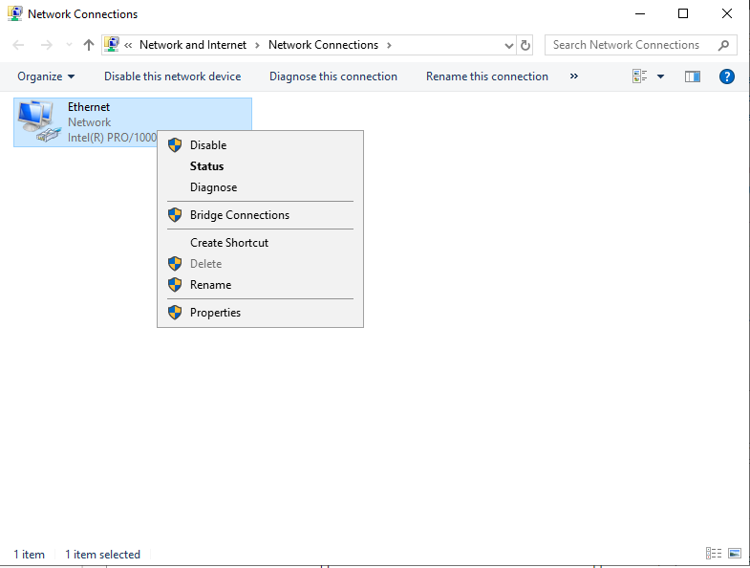
Windows Server Basic Configuration Task (Assign Static IP Address)
Select the link next to “Ethernet” (currently showing that IP address is assigned by Dynamic Host Control Protocol (DHCP))
This opens the “Network Connections” setting. Right click on the Ethernet connection and select “Properties”

Slide 11
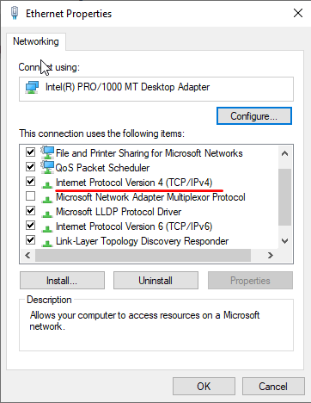
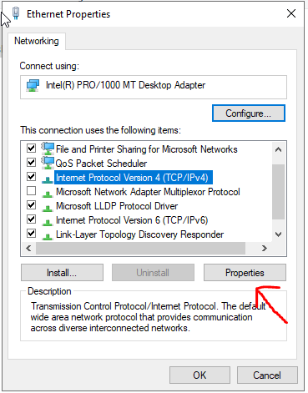
Windows Server Basic Configuration Task (Assign Static IP Address cont.)
In the Ethernet Properties window locate “Internet Protocol Version 4 (TCP/IPv4)”
Click the text to highlight it and then select “Properties”

Slide 12
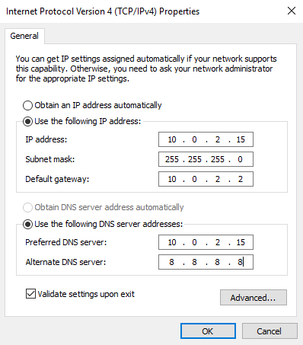
Windows Server Basic Configuration Task (Assign Static IP Address cont.)
Select the “Use the following IP address” radio button
Specify an address in the subnet, in this case 10.0.2.15
Specify Subnet mask, in this case 255.255.255.0 or /24 CIDR
Default gateway is set to the current default gateway being used. (address can be found by using the “ipconfig” command in the command prompt)
Preferred DNS Server is set to the address of this server as it will be the DNS server for this lab environment once DNS services are added and configured
Click “OK” then close out of the “Ethernet properties” and “Network Connections” window

Slide 13
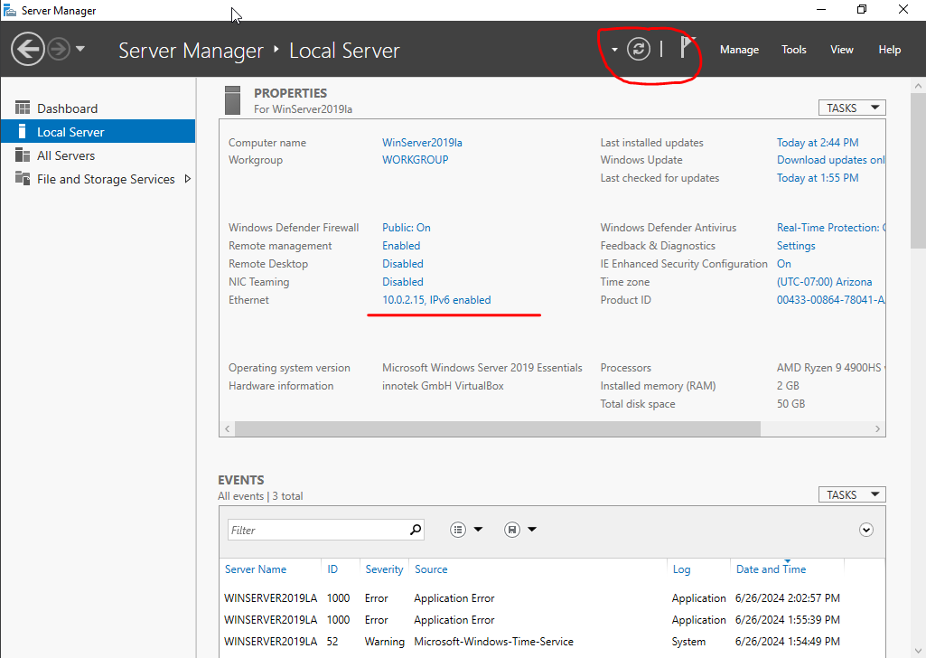
Windows Server Basic Configuration Task (Assign Static IP Address cont.)
Setting shown next to “Ethernet” should now show the IPv4 address assigned
If not click the refresh button at the top of the window

Slide 14
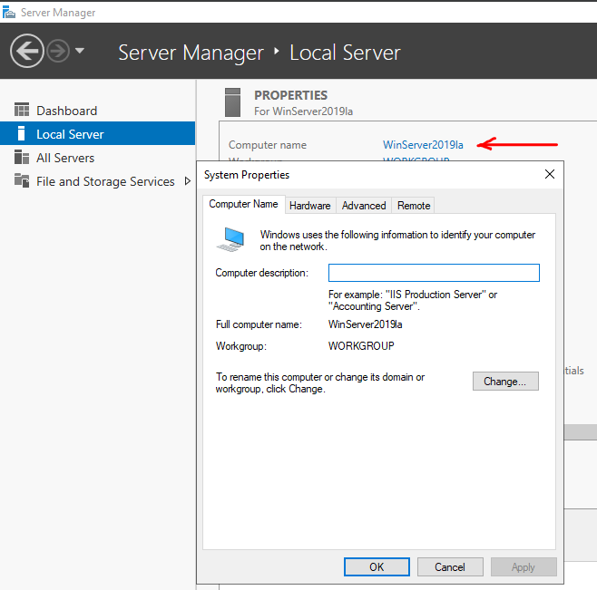
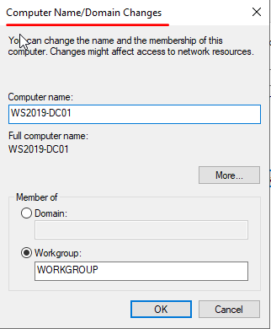
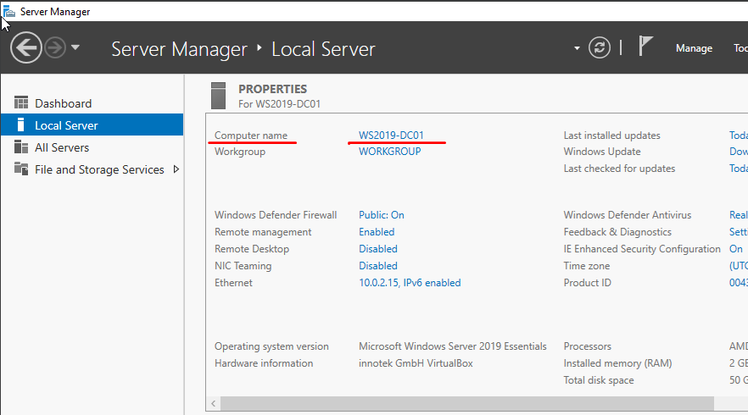
Windows Server Basic Configuration Task (Renaming server)
Click on the current server's name next to “Computer name” bringing up the System Properties window
Click the “Change…” button to bring up the “Computer Name/Domain changes” window
Assign the desired name for the server, for this lab “WS2019-DC01” then click “OK”
Must restart server for name changes to apply
After restarting we can see the Computer Name has now been updated

Slide 15
Setting up Active Directory
You must first Install the Active Directory Domain Services role on the server
Afterwards you must promote the server to a Domain Controller

Slide 16
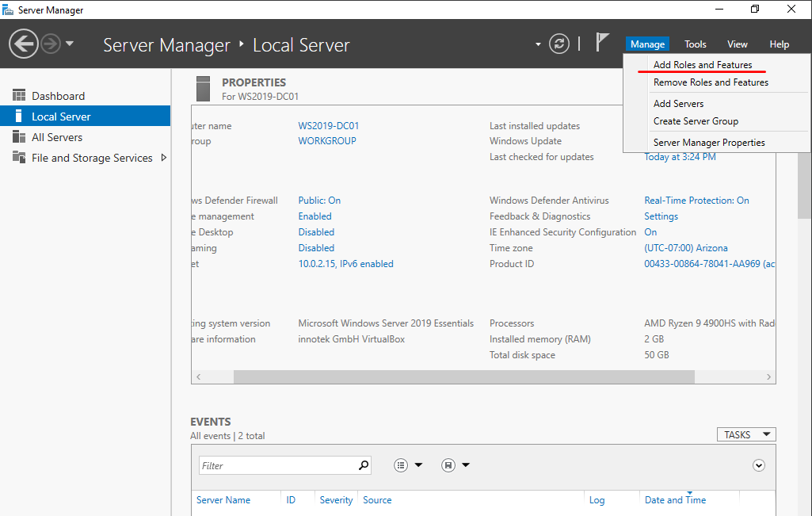
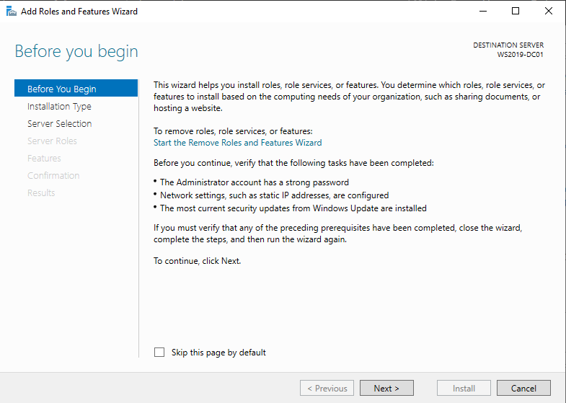
Installing Active Directory Domain Services
From the Server Manager application Click on “Manage” in the top right corner then “Add Roles and Features”
This brings up the “Add Roles and Features Wizard”; at the “Before you begin page” review the necessary tasks and hit “Next”

Slide 17
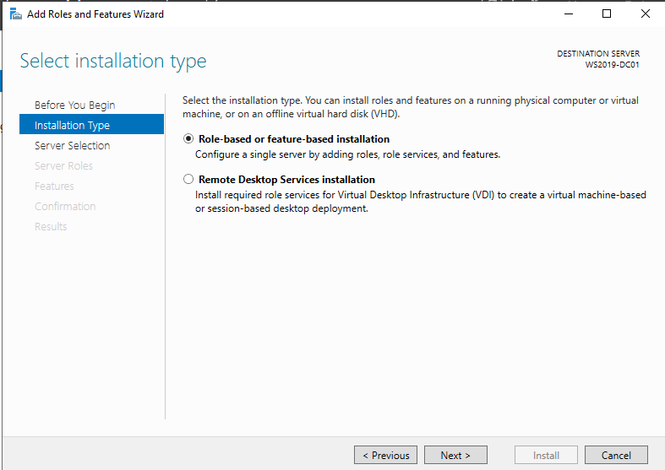
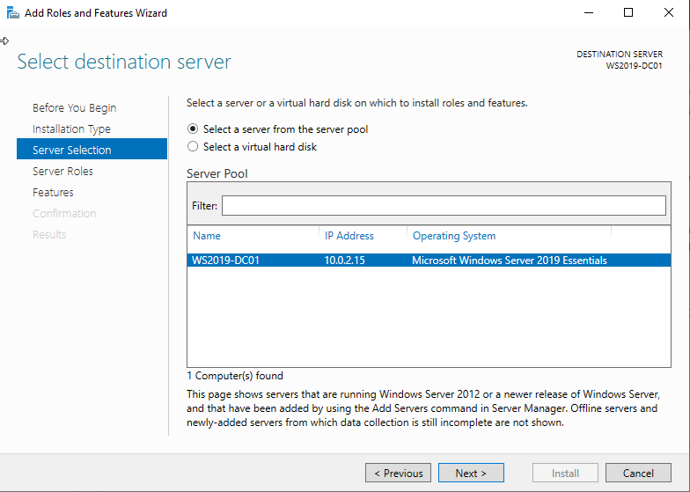
Installing Active Directory Domain Services (cont.)
Select installation type:
Select “Role-based or feature-based installation then “Next”
Select destination server:
Select a server from the server pool > ensure the server highlighted is your local server
Hit “Next”

Slide 18
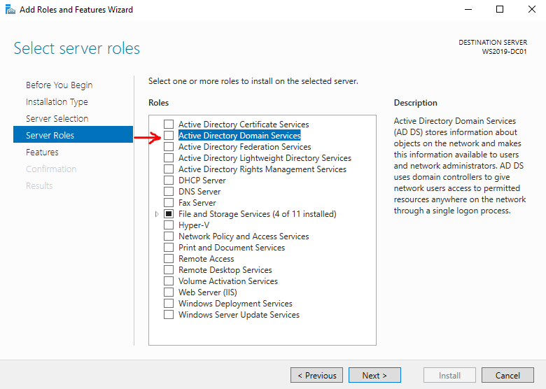
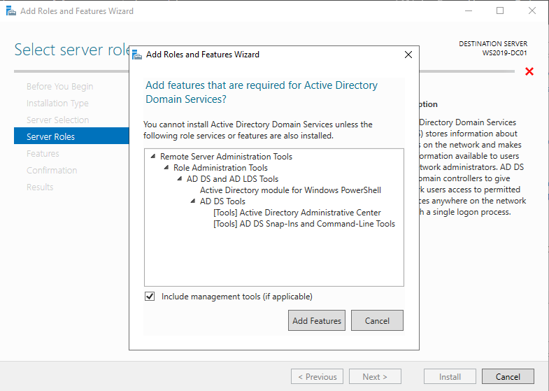
Installing Active Directory Domain Services (cont.)
Select server roles:
Select the Active Directory Domain Services checkbox
At the pop-up window leave the “include management tools” checkbox checked and hit “Add features”

Slide 19
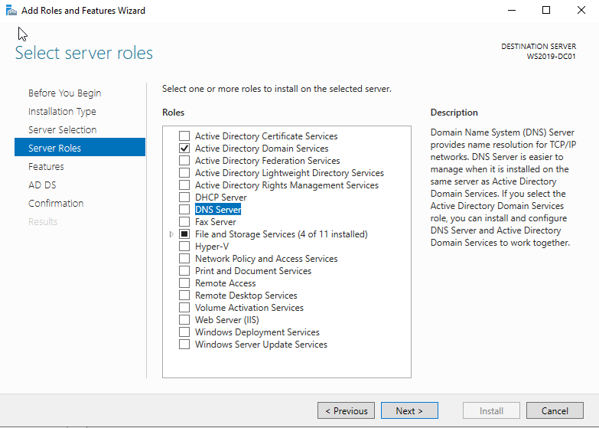
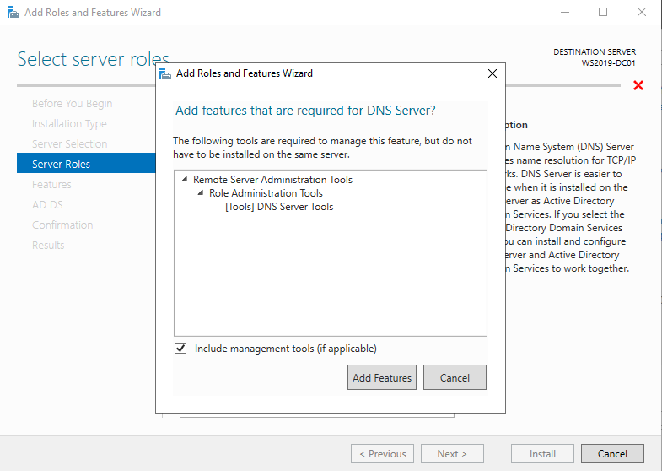
Installing Active Directory Domain Services (cont.)
Select server roles:
In addition to Active Directory services, select the check box to include the “DNS Server” role as well
At the pop-up window check the box to include management tools then click “

Slide 20
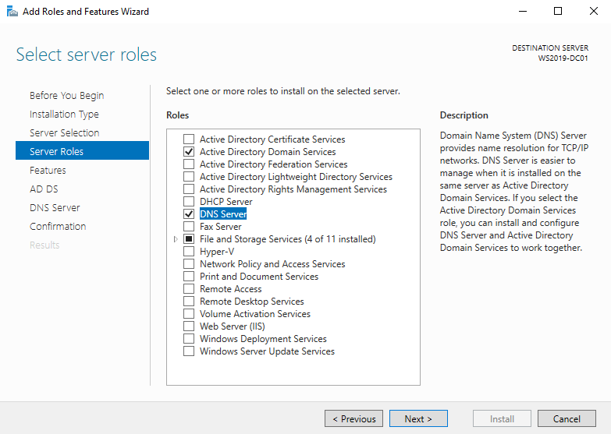
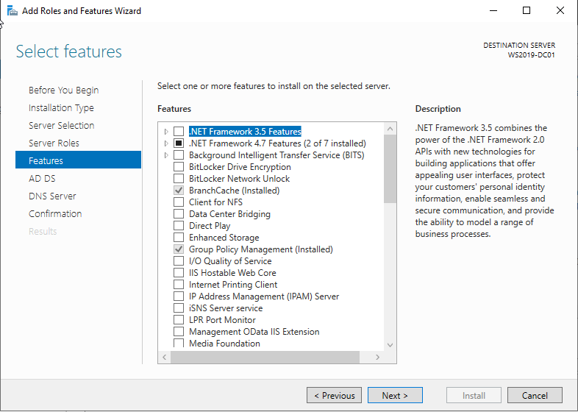
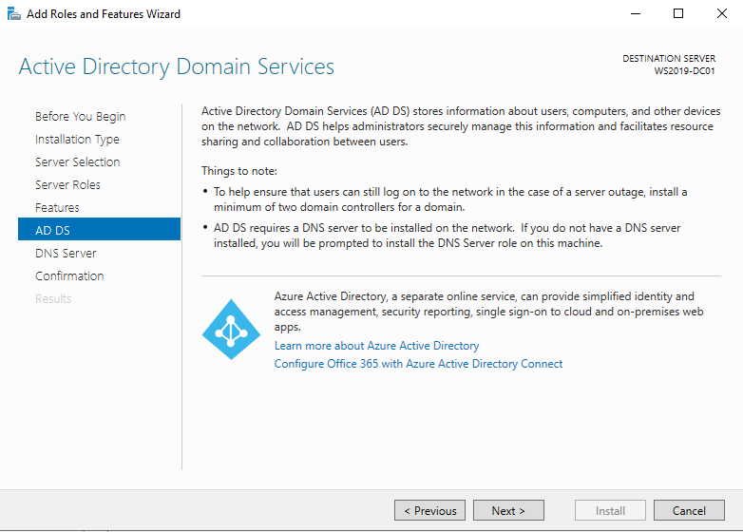
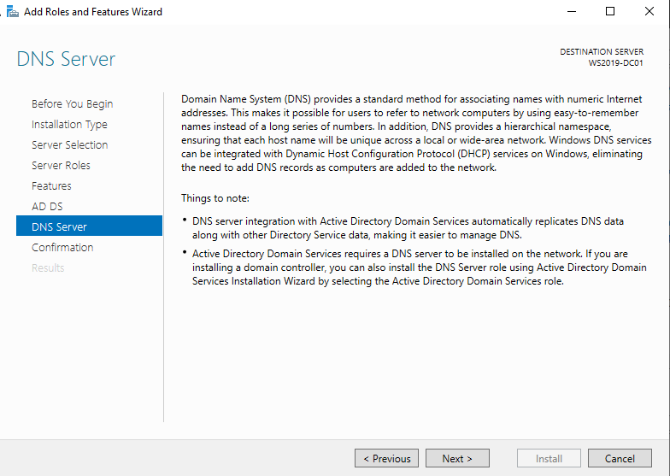
Installing Active Directory Domain Services (cont.)
After selecting the needed roles, hit “Next”
Select Features:
Hit “Next”
Active Directory Domain Services:
Hit “Next”
DNS Server:
Hit “Next”

Slide 21
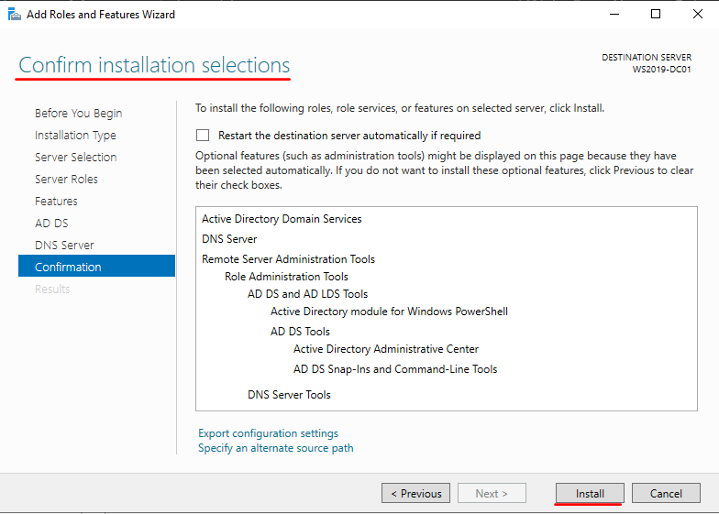
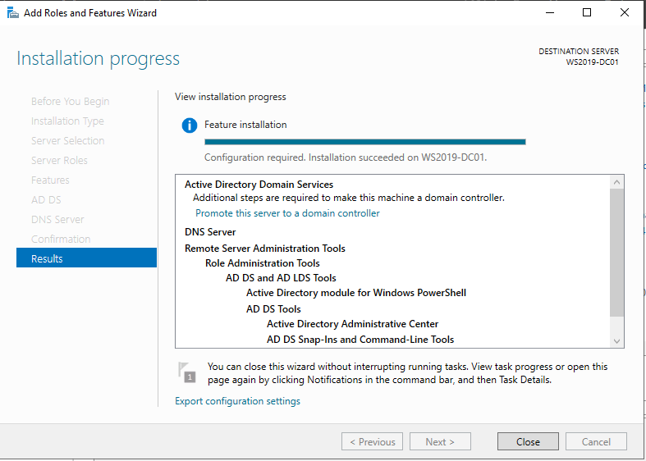
Installing Active Directory Domain Services (cont.)
Confirm Installation Selections:
Click “Install”
After the installation has completed, click the text “Promote this server to a domain controller” which will bring up the Active Directory Domain Services configuration wizard.

Slide 22
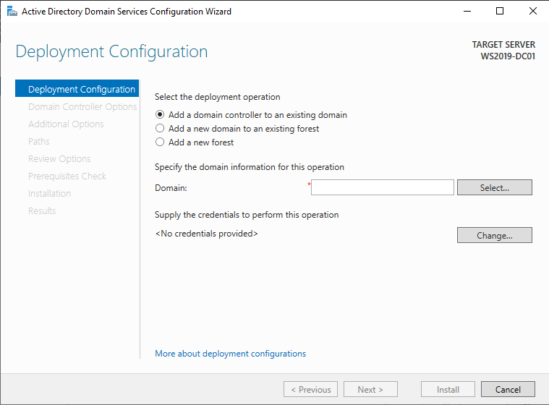
Installing Active Directory Domain Services (cont.)
At Deployment Configuration, select the radio button to “Add a new forest”
Specify the name of the root domain, for this lab I will be using “virtuallab.local”
Then click “Next”

Slide 23
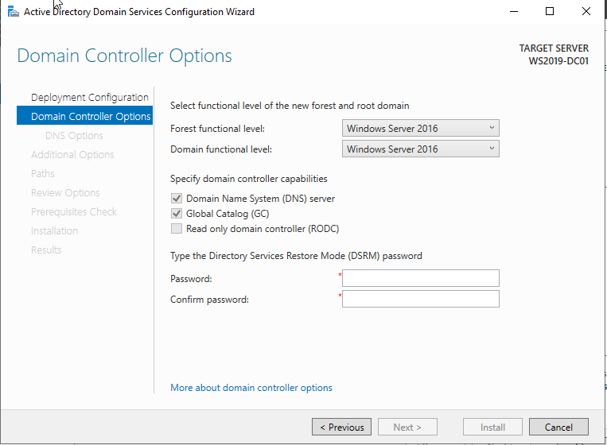
Installing Active Directory Domain Services (cont.)
For Domain Controller options we can leave the Forest and Domain function level options as Windows Server 2016 as that is the current maximum functional level
Leave the Domain Name System server and Global catalog boxes checked
Assign a password for Directory Services Restore Mode and click “Next” once finished

Slide 24
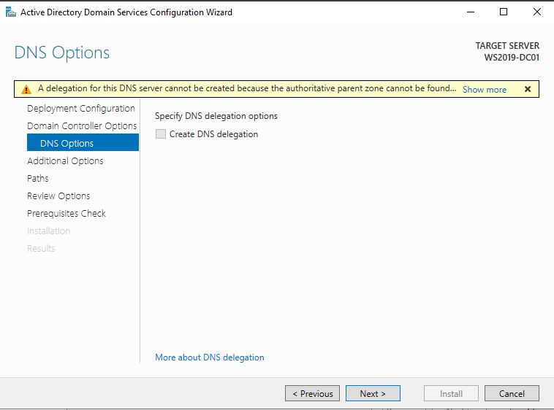
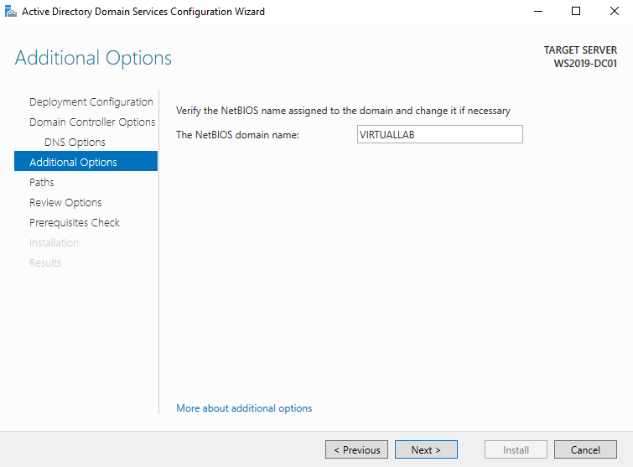
Installing Active Directory Domain Services (cont.)
Click “Next” on the DNS options page leaving the box unchecked
On the additional options page, a name will be assigned based on the name of the domain you specified earlier, you may change the NetBIOS domain name however for this lab I accepted the given name.
Click next to the “Paths” page

Slide 25
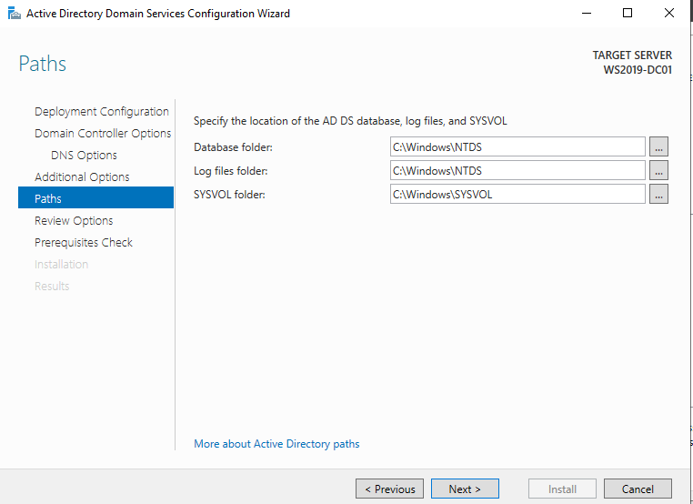
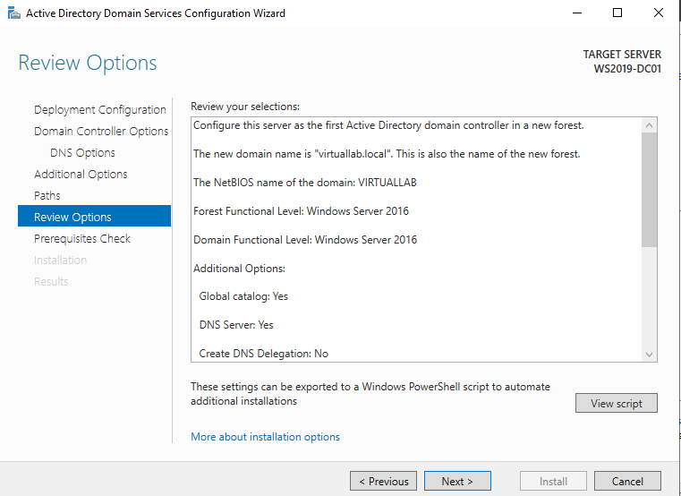
Installing Active Directory Domain Services (cont.)
Click “Next” on the Paths page, accepting the default paths.
At the Review Options page, review your selections and then click next, otherwise you may go back and change anything you missed.

Slide 26
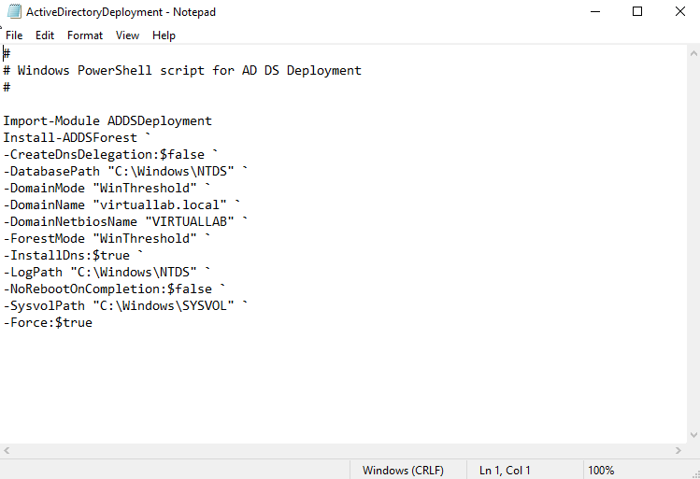
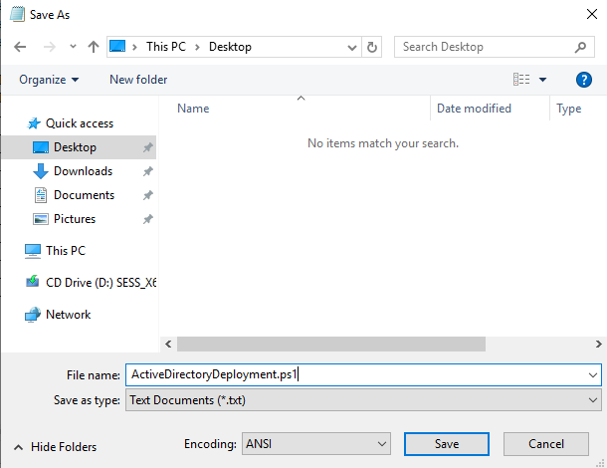
Installing Active Directory Domain Services (cont.)
At the Review Options page click the View Script button
This will show the PowerShell script which will run to set up this active directory server
Save a copy of this file to your Documents for reference and to assist in automating Active Directory Deployment for future labs
Save as a .ps1 file

Slide 27
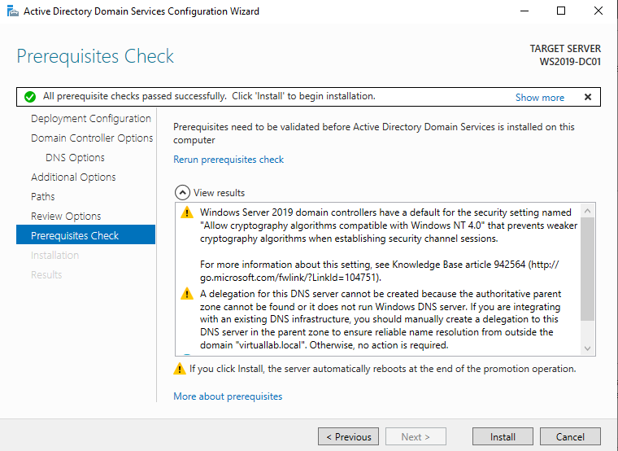
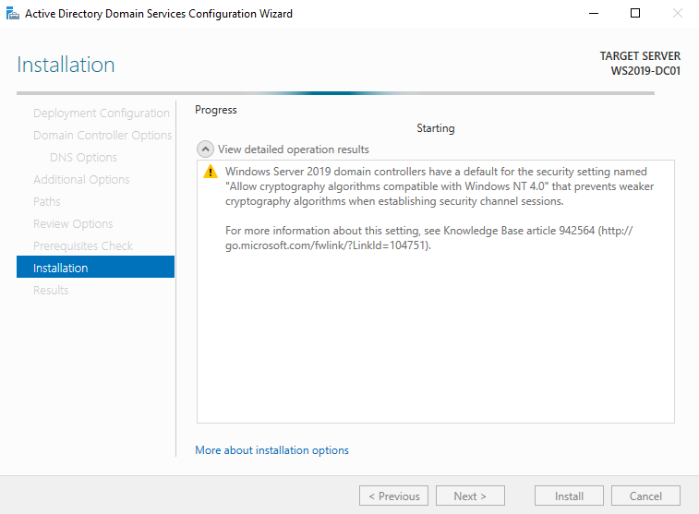
Installing Active Directory Domain Services (cont.)
After Saving the script a click “Next” at the review options page
The prerequisite check will run automatically
If all checks passed you may then Click “Install”
If prerequisite check was unsuccessful, go back and ensure all previous steps in this lab were completed
Sever will automatically restart during installation

Slide 28
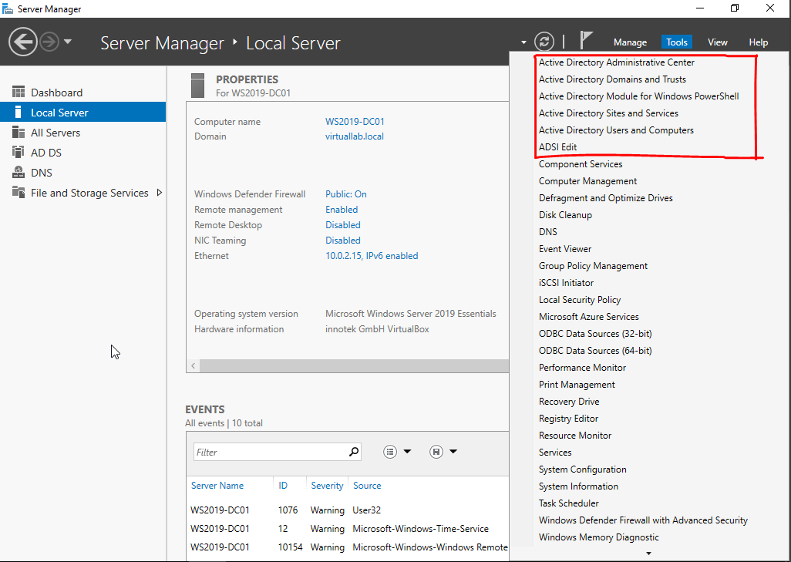
Installing Active Directory Domain Services (cont.)
After the server restarts, sign back in and open up server manager
Under “Tools” There should now be Services for managing Active Directory

Slide 29
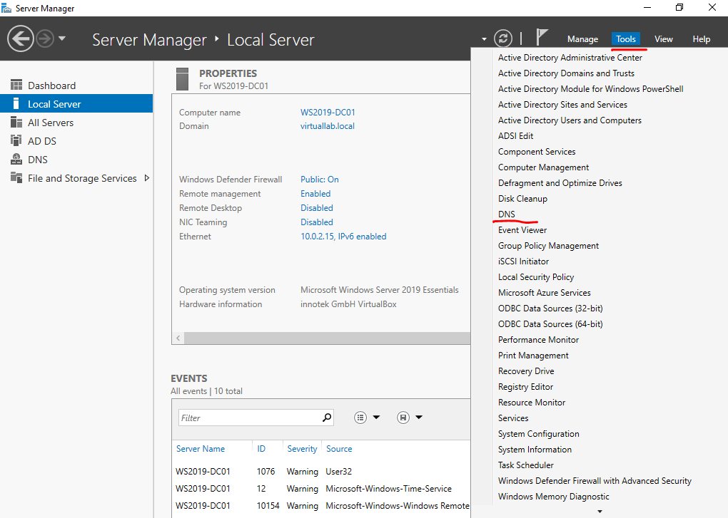
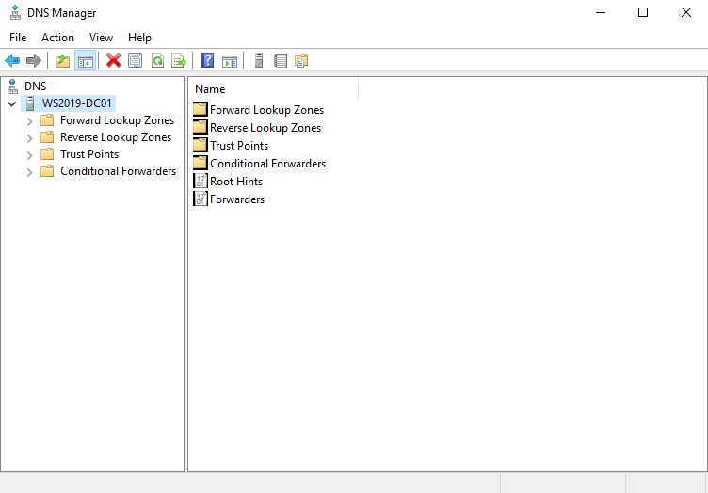

Configuring DNS
Click on “Tools”in the upper right corner
Select “DNS” to open the DNS manager
at Server Manager double click the server name to expand
Right click on “Reverse Lookup Zones” and select “New Zone…”

Slide 30

Configuring DNS (cont.)
Click “Next” on the New Zone Wizard welcome page
Select “Primary Zone”
Ensure the box is checked at the bottom to integrate with Active Directory
Click “Next”

Slide 31


Configuring DNS (cont.)
At the Active Directory Zone Replication Scope settings select “ To all DNS servers running on domain controllers in this domain…”
Click “Next”
For Reverse Lookup Zone Name, select the option for IPv4
Click “Next”

Slide 32


Configuring DNS (cont.)
At the next page ensure the “Network ID” option is selected and enter the network ID of the server IP address
This servers IP address is 10.0.2.15/24 so the network address will be 10.0.2.0
Click “Next”
Leave “Allow only secure dynamic updates” selected and click “Next”

Slide 33


Configuring DNS (cont.)
Click “Finish”
In DNS Manager we can now see the Reverse Lookup Zone we created
This will allow us to translate IP addresses into Hostnames on the network

Slide 34


Configuring DNS (cont.)
Next select the local zone and double-click the host record for the server domain name to open the file
Check the box to “Update associated pointer (PTR) record”
Click “Apply” then “Okay”

Slide 35

Configuring DNS (cont.)
Select the Reverse Lookup Zone and verify there is now a new pointer record created
Close “DNS Manager”

